Slide 1


Correlation Detective
Efficient detection of multivariate correlations in static and streaming data (Multivariate Similarity Search)
Jens d’Hondt, Odysseas Papapetrou, Koen Minartz

Slide 2


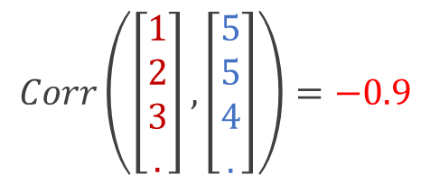

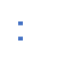
Introduction
Multivariate correlations
$$Corr\left(\left[\begin{aligned}1 \\ 2 \\ 3 \\ .\end{aligned}\right],\left[\begin{aligned}5 \\ 5 \\ 4 \\ .\end{aligned}\right]\right)=−0.9$$
$$..$$
$$..$$
Correlation Analysis is a common tool for Complex Data Analysis
Most research has been focused on discovery of pairwise relations
-0.3
SYDNEY
-0.9
LA
0.5
PARIS

Slide 3

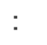

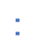
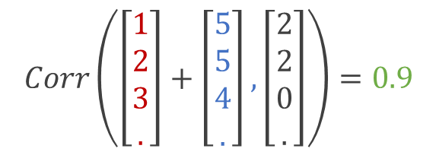
Introduction
Multivariate correlations
$$Corr\left(\left[\begin{aligned}1 \\ 2 \\ 3 \\ .\end{aligned}\right]+\left[\begin{aligned}5 \\ 5 \\ 4 \\ .\end{aligned}\right],\left[\begin{aligned}2 \\ 2 \\ 0 \\ .\end{aligned}\right]\right)=0.9$$
$$..$$
$$..$$
$$..$$
Correlation Analysis is a common tool for Complex Data Analysis
Most research has been focused on discovery of pairwise relations
SYDNEY
Recent work shows importance of multivariate correlations
0.9
SUM
LA
PARIS

Slide 4
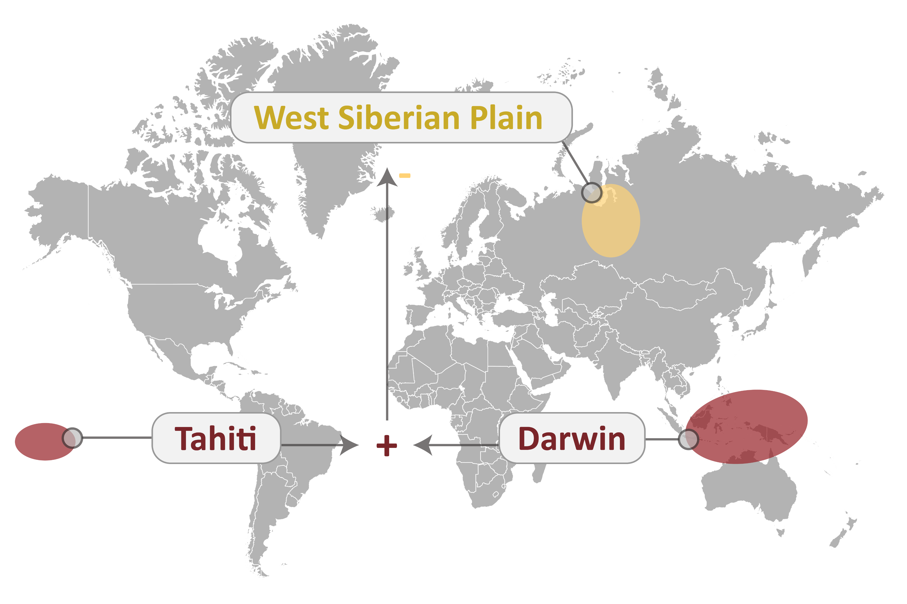
Introduction
Multivariate correlations
Correlation Analysis is a common tool for Complex Data Analysis
Most research has been focused on discovery of pairwise relations
Recent work shows importance of multivariate correlations

Slide 5
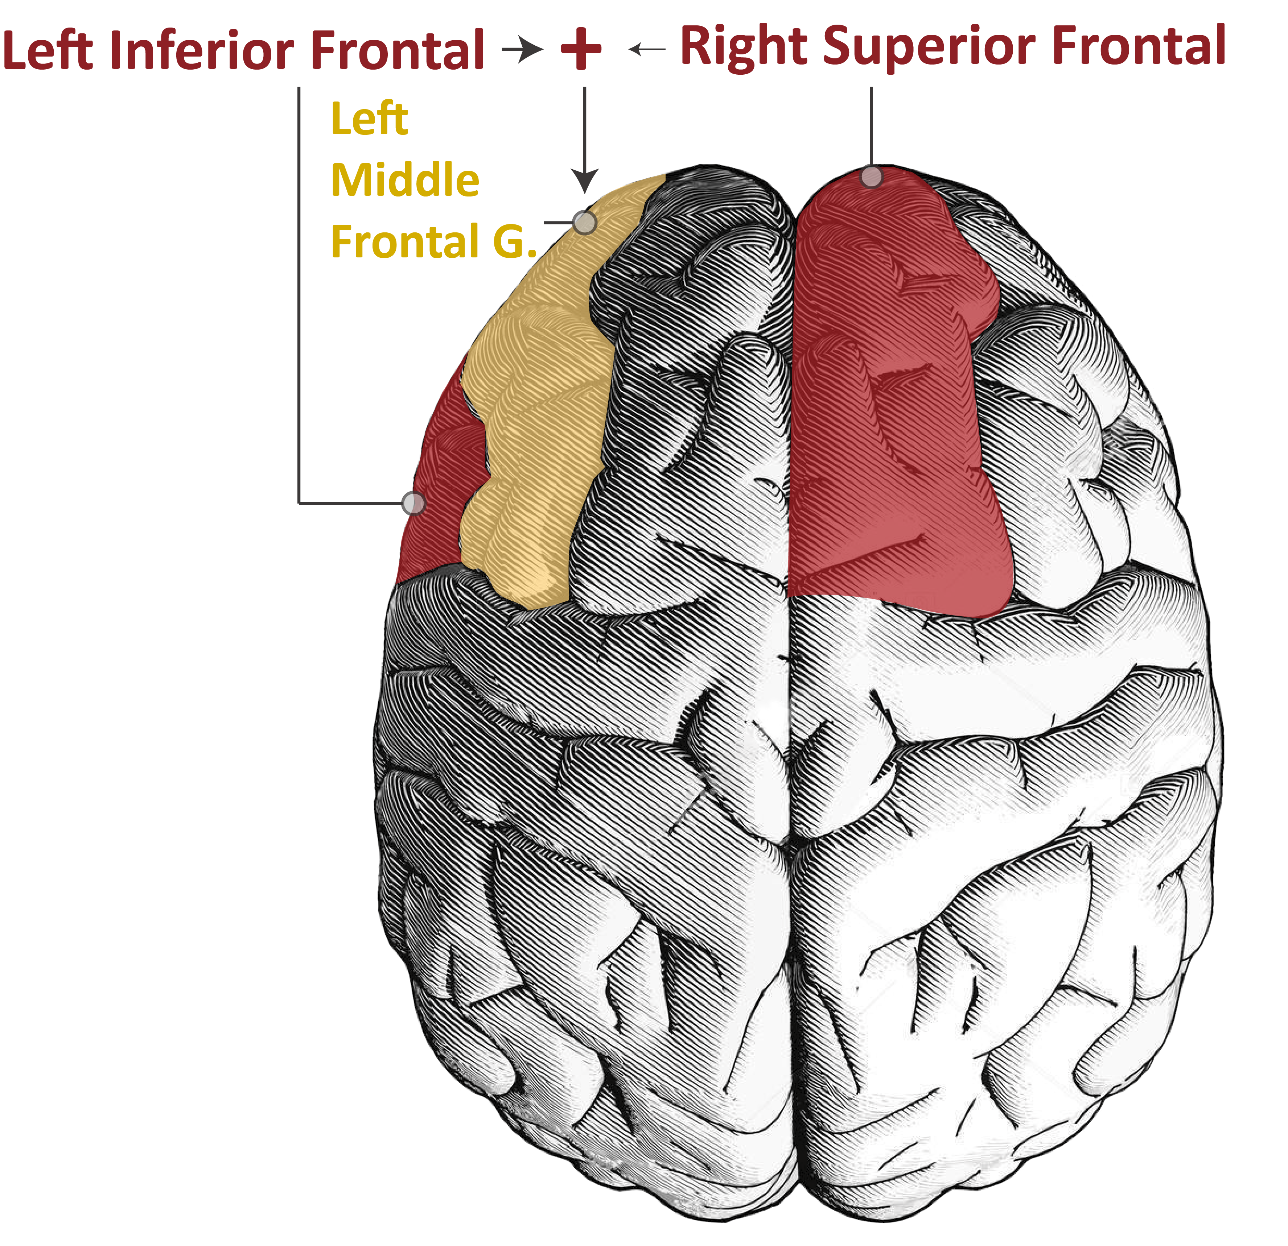

Introduction
Multivariate correlations
Correlation Analysis is a common tool for Complex Data Analysis
Most research has been focused on discovery of pairwise relations
Recent work shows importance of multivariate correlations
Other examples: neuroscience, finance, medicine, genomics, ...

Slide 6


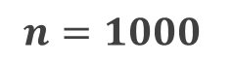

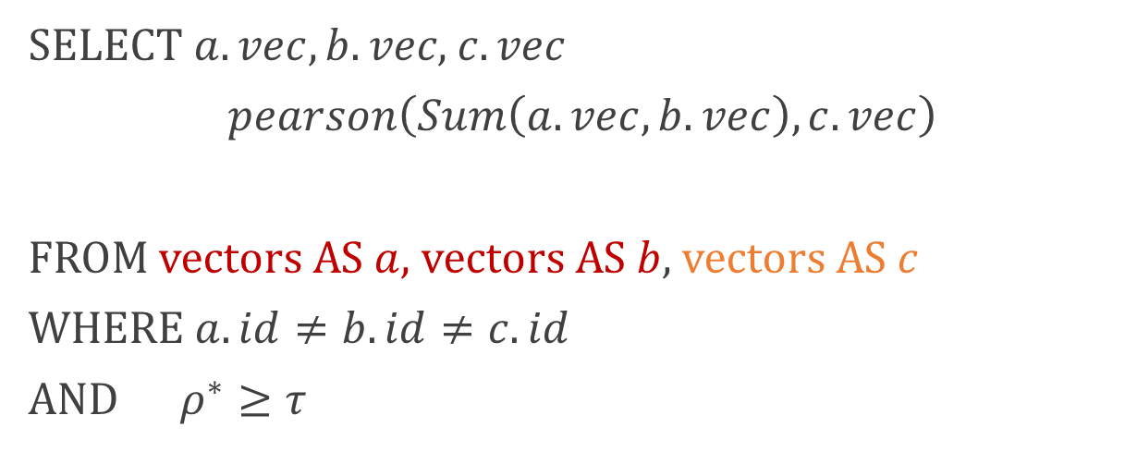
Introduction
Computational complexity
Group size = 3
$$O(\left(\begin{matrix}n \\ 3\end{matrix}\right))$$
$$Corr(a+b, c)$$
Fundamental challenge: #combinations
SELECT$a.vec,b.vec\text{, }c.vec$
$$pearson\left(Sum\left(a.vec,b.vec\right), c.vec\right)$$
FROM vectors AS $a$, vectors AS $b$, vectors AS $c$
WHERE $a.id≠b.id≠c.id$
AND $ρ^{∗}≥τ$
Correlation pattern
…
Corr. measure
Aggregation function
2
3
4
Query type
~500 K
~500 M
~500 B
$$n=1000$$
(1 sec)
(7 min)
(1.5 day)
$∗ρ$ is short-hand for $pearson(Sum\left(a.vec,b.vec\right),c.vec)$

Slide 7

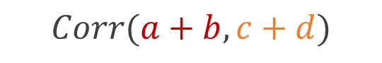
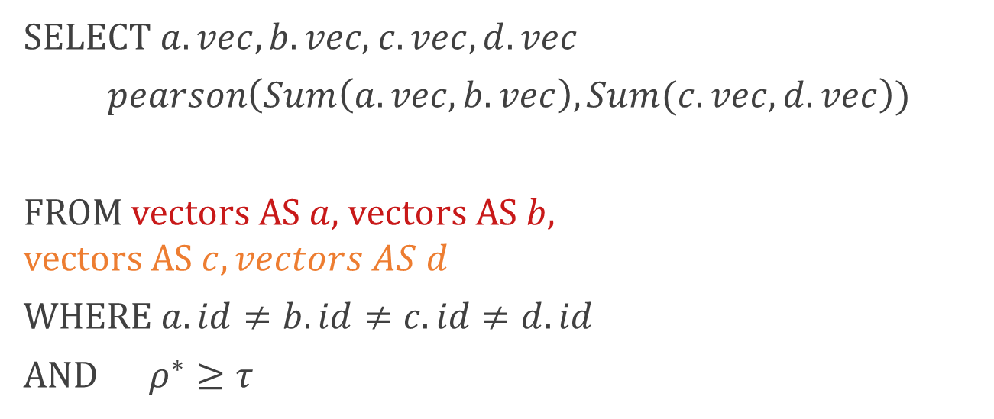
Introduction
Computational complexity
Group size = 4
$$O(\left(\begin{matrix}n \\ 4\end{matrix}\right))$$
$$Corr(a+b, c+d)$$
Fundamental challenge: #combinations
SELECT$a.vec,b.vec\text{, }c.vec, d.vec$
$$pearson\left(Sum\left(a.vec,b.vec\right), Sum(c.vec,d.vec\right))$$
FROM vectors AS $a$, vectors AS $b$, vectors AS $c, vectors AS d$
WHERE $a.id≠b.id≠c.id≠d.id$
AND $ρ^{∗}≥τ$
Correlation pattern
…
Corr. measure
Aggregation function
2
3
4
Query type
~500 K
~500 M
~500 B
$$n=1000$$
(1 sec)
(7 min)
(1.5 day)
$∗ρ$ is short-hand for $pearson(Sum\left(a.vec,b.vec\right),Sum\left(c.vec,d.vec\right))$

Slide 8


Introduction
Computational complexity
Group size = 4
$$O(\left(\begin{matrix}n \\ 4\end{matrix}\right))$$
$$Corr(a+b, c+d)$$
Fundamental challenge: #combinations
…
Apriori-like methods not possible
2
3
4
Current solutions: one-shot and no completeness guarantees
~500 K
~500 M
~500 B
$$n=1000$$
(1 sec)
(7 min)
(1.5 day)

Slide 9



Past work
Limited to…
Problem statements that support Apriori filtering
E.g. require subset correlations to be high.
Agrawal 2017, Nguyen 2014, Zhang 2008
Particular data types
E.g. only binary data
Agrawal [2017, 2020], Zhang 2008
Approximate results, no completeness guarantees
E.g. prioritize combinations/cliques based on heuristics
Agrawal [2017, 2020]

Slide 10



Correlation Detective
Generic solution
Query parameters
Extensions
Correlation Measures
[Agg. Pearson, Agg. Euclidean, Multipoles, Total Correlation]
Progressive Algorithm
Speed-up through prioritization
Query Types
[Threshold query, Top-k]
Streaming algorithm
With sub-second responses
Additional constraints (optional)
E.g., only low pairwise correlations

Slide 11
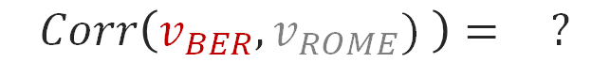
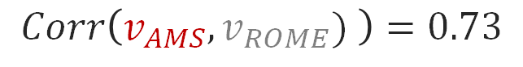

Correlation Detective
Intuition
AMS
ROME
0.73
Vectors
$$Corr\left(v_{AMS}, v_{ROME}) \right)=0.73$$
CLUSTER 1
CLUSTER 2
$$Corr\left(v_{BER}, v_{ROME}) \right)= ?$$
[0.7,0.75]
0.98
[LB,UB]
?
Clusters
BERLIN
$$Corr\left(C_{1},C_{2}\right)∈[0.7,0.75]$$

Slide 12


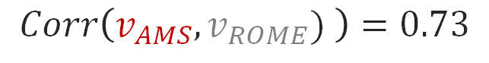

Correlation Detective
Intuition
Vectors
$$Corr\left(v_{AMS}, v_{ROME}) \right)=0.73$$
CLUSTER 1
$$Corr\left(v_{BER}, v_{ROME}) \right)= ?$$
CLUSTER 2
SUM
[0.5,0.9]
Clusters
$$Corr\left(C_{1},C_{2}\right)∈[0.7,0.75]$$
[LB,UB]
CLUSTER 3
Multivariate
$$Corr(Sum\left(C_{1},C_{3}\right),C_{2})∈[0.5,0.9]$$

Slide 13
Correlation Detective
Algorithm
01
Z-normalization – normalize all points
02
Hierarchical Clustering – K-means++
03
Recursive Bounding –bound
correlation of cluster combinations based on cluster radii and centroid

Slide 14
Correlation Detective
Algorithm
01
Z-normalization – normalize all points
02
Hierarchical Clustering – K-means++
03
Recursive Bounding –bound
correlation of cluster combinations based on cluster radii and centroid

Slide 15
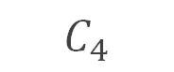
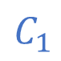
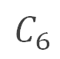
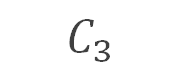
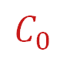
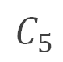
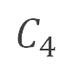
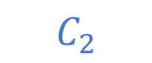
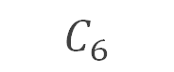
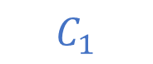
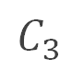
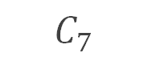
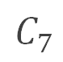
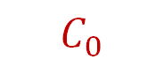
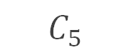
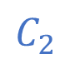
Correlation Detective
Algorithm
$$C_{3}$$
Cluster tree
01
$$C_{6}$$
$$C_{0}$$
Z-normalization – normalize all points
$$C_{4}$$
$$C_{1}$$
$$C_{1}$$
$$C_{2}$$
$$C_{2}$$
02
$$C_{0}$$
Hierarchical Clustering – K-means++
$$C_{3}$$
$$C_{4}$$
$$C_{5}$$
$$C_{6}$$
$$C_{7}$$
Recursive Bounding –bound
correlation of cluster combinations based on cluster radii and centroid
$$C_{7}$$
03
$$C_{5}$$

Slide 16
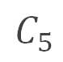

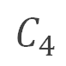
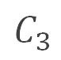
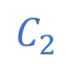
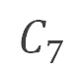
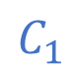
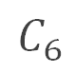
Correlation Detective
Algorithm
$$C_{0}$$
$$C_{1}$$
$$C_{2}$$
01
Z-normalization – normalize all points
$$C_{3}$$
$$C_{4}$$
$$C_{5}$$
$$C_{6}$$
$$C_{7}$$
02
Hierarchical Clustering – K-means++
03
Recursive Bounding –bound
correlation of cluster combinations based on cluster radii and centroid

Slide 17

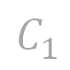




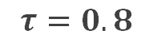
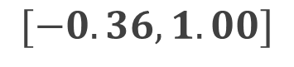

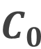

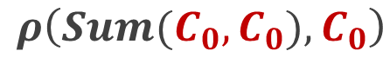

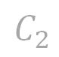
Correlation Detective
Algorithm
$$C_{0}$$
$$C_{1}$$
$$C_{2}$$
01
$$τ=0.8$$
Z-normalization – normalize all points
$$C_{3}$$
$$C_{4}$$
$$C_{5}$$
$$C_{6}$$
$$C_{7}$$
02
Hierarchical Clustering – K-means++
$$C_{0}$$
$$ρ\left(Sum(C_{0},C_{0}),C_{0}\right)$$
03
Recursive Bounding –bound
correlation of cluster combinations based on cluster radii and centroid
$$C_{0}$$
$$∈$$
$$C_{0}$$
$[−0.36,1.00]$
Indecisive

Slide 18
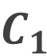
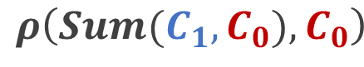
Correlation Detective
Algorithm
$$C_{0}$$
$$C_{1}$$
$$C_{2}$$
01
$$τ=0.8$$
Z-normalization – normalize all points
$$C_{3}$$
$$C_{4}$$
$$C_{5}$$
$$C_{6}$$
$$C_{7}$$
02
Hierarchical Clustering – K-means++
$$C_{1}$$
$$ρ\left(Sum(C_{1},C_{0}),C_{0}\right)$$
03
Recursive Bounding –bound
correlation of cluster combinations based on cluster radii and centroid
$$C_{0}$$
$$∈$$
$$C_{0}$$
$[−0.36,1.00]$
Indecisive

Slide 19
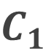
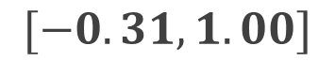
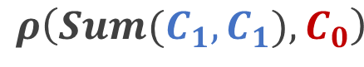
Correlation Detective
Algorithm
$$C_{0}$$
$$C_{1}$$
$$C_{2}$$
01
$$τ=0.8$$
Z-normalization – normalize all points
$$C_{3}$$
$$C_{4}$$
$$C_{5}$$
$$C_{6}$$
$$C_{7}$$
02
Hierarchical Clustering – K-means++
$$C_{1}$$
$$ρ\left(Sum(C_{1},C_{1}),C_{0}\right)$$
03
Recursive Bounding –bound
correlation of cluster combinations based on cluster radii and centroid
$$C_{0}$$
$$∈$$
$$C_{1}$$
$[−0.31,1.00]$
Indecisive

Slide 20
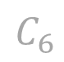

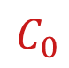








Correlation Detective
Algorithm
$$C_{0}$$
$$C_{1}$$
$$C_{2}$$
01
$$τ=0.8$$
Z-normalization – normalize all points
$$C_{3}$$
$$C_{4}$$
$$C_{5}$$
$$C_{6}$$
$$C_{7}$$
02
Hierarchical Clustering – K-means++
$$C_{1}$$
$$ρ\left(Sum(C_{1},C_{1}),C_{1}\right)$$
03
Recursive Bounding –bound
correlation of cluster combinations based on cluster radii and centroid
$$C_{1}$$
$$∈$$
$$C_{1}$$
$[−0.26,1.00]$
Indecisive

Slide 21



Correlation Detective
Algorithm
$$C_{0}$$
$$C_{1}$$
$$C_{2}$$
01
$$τ=0.8$$
Z-normalization – normalize all points
$$C_{3}$$
$$C_{4}$$
$$C_{5}$$
$$C_{6}$$
$$C_{7}$$
02
Hierarchical Clustering – K-means++
$$C_{2}$$
$$ρ\left(Sum(C_{2},C_{1}),C_{1}\right)$$
03
Recursive Bounding –bound
correlation of cluster combinations based on cluster radii and centroid
$$C_{1}$$
$$∈$$
$$C_{1}$$
$[−0.36,0.51]$
Decisive

Slide 22






Evaluation
Stock
Trade data from NYSE
Experimental setup
SLP
Sea Level Pressure measurements
Goal: assess scalability and sensitivity on varying input parameters and datasets
Temp
Temperature sensor data
Crypto
Prices of crypto-currencies
Compare to state-of-the-art and an exhaustive search baseline
fMRI
Functional MRI data
Deep
Output vectors of neural net

Slide 23


Evaluation
Scalability
Experiment results
$$Pearson(v_{0},Avg\left(v_{1},v_{2},v_{3}\right))$$
Scalability
CD scales better than exhaustive baseline

Slide 24



Evaluation
Scalability
Experiment results
Scalability
CD scales better than exhaustive baseline
SOTA comparison
CD finds more results in less time
SOTA comparison
Insight
CD relies on the ability to cluster a dataset

Slide 25
Paper
Scope
Query parameters
Extensions
Correlation Measures
[Agg. Pearson, Agg. Euclidean, Multipoles, Total Correlation]
Progressive Algorithm
Speed-up through prioritization
Query Types
[Threshold query, Top-k]
Streaming algorithm
With sub-second responses
Additional constraints (optional)
E.g., only low pairwise correlations

Slide 26

Looking forward
Vision
Motivation: Every researcher/analyst uses different similarity measures and (custom) constraints
Goal 1: Build theoretic framework & optimization strategies to support any measure, aggregation, and constraint (with certain properties)
Goal 2: Build an optimizer & distributed executor that dynamically constructs efficient execution strategy

Slide 27


Introduction
Computational complexity
Group size = 4
$$O(\left(\begin{matrix}n \\ 2\end{matrix}\right)∗\left(\begin{matrix}n−2 \\ 2\end{matrix}\right))$$
$$Corr(a+b, c+d)$$
Fundamental challenge: #combinations
SELECT$a.vec,b.vec\text{, }c.vec, d.vec$
$$pearson\left(Avg\left(a.vec,b.vec\right), Avg(c.vec,d.vec\right))$$
FROM vectors AS $a$, vectors AS $b$, vectors AS $c, vectors AS d$
WHERE $a.id≠b.id≠c.id≠d.id$
AND $ρ^{∗}≥τ$
Correlation pattern
…
Corr. measure
Aggregation function
2
3
4
Query type
~500 K
~500 M
~500 B
$$n=1000$$
(1 sec)
(7 min)
(1.5 day)
$∗ρ$ is short-hand for $mc\left(2,2\right)$ or $pearson(Avg\left(a.vec,b.vec\right),Avg\left(c.vec,d.vec\right))$

Slide 28








Preliminaries
Queries (described in SQL lingo)
Query
Query type
Corr metric
SELECT$a.vec,b.vec\text{, }c.vec\text{,}$
$pearson\left( Avg\left( a.vec,b.vec \right), c.vec \right)$
FROM vectors AS $a$, vectors AS $b$, vectors AS $c$
WHERE $a.id≠b.id≠c.id$
AND $ρ^{∗}≥ τ$
Correlation pattern
Top-k
Multi-Pearson
…
$$mc(..,..)$$
Corr. measure
Aggregation function
Threshold
Multipole
…
$$mp(..)$$
Aggregation
Constraints
Query type
Sum
Irreducibility (no supersets)
AND $pearson\left(a.vec,b.vec\right)+δ≤ρ$
AND $pearson\left(a.vec,c.vec\right)+δ≤ρ$
AND $pearson\left(b.vec,c.vec\right)+δ≤ρ$
$$Sum(..)$$
$$…$$
Additional
constraints
Average
Minimum jump (no strong subsets)
$$Avg(..)$$
$$…$$
$∗ρ$ is short-hand for $mc\left(2,1\right)$ or $pearson(Avg\left(a.vec,b.vec\right), c.vec)$
Notes:
We have bounds on these multiple correlations which depend on the pairwise correlations of vectors in sets

Slide 29

Questions
Bounds on multi-pearson
$$mc\left(X, Y\right)=\frac{\sum_{x∈X, y∈Y}{ρ(x, y)}}{√\sum_{i∈X, j∈X}{ρ\left(i,j\right)}√\sum_{i∈Y, j∈Y}{ρ\left(i,j\right)}}$$
$$\frac{\sum_{x∈X, y∈Y}{l(x, y)}}{√\sum_{i∈X, j∈X}{u\left(i,j\right)}√\sum_{i∈Y, j∈Y}{u\left(i,j\right)}} ≤mc\left(X, Y\right)≤ \frac{\sum_{x∈X, y∈Y}{u(x, y)}}{√\sum_{i∈X, j∈X}{l\left(i,j\right)}√\sum_{i∈Y, j∈Y}{l\left(i,j\right)}}$$

Slide 30

Questions
Additional experiments
Clustering parameters

Slide 31

Questions
Additional experiments
Other datasets

Slide 32


Questions
Additional experiments
Sensitivity
4-correlations – Multiple Pearson

Slide 33



Questions
Additional constraints
Irreducibility
Result set
Irreducibility: prioritize smaller combinations in result set
ABCD
ABC
Minimum jump: only consider combinations that would not have been found with pairwise correlation analysis
Minimum jump
$$δ=0.05$$
ABCD 0.92
Result set
ABC 0.9
ABCE 0.98

Slide 34
Questions
Negative correlations
Positive correlations
Negative correlations
Both correlations

Slide 35


Questions
DCC Index – in-depth
Group on content -> extrema pairs -> clusters
Clusters are sorted based on size
DCCs are stored as much as their size

Slide 36

Questions
MC-bounds

Slide 37

CDStream
Methodology
Goal: find and maintain result set Challenge: combinations of streams $(\left\{s_{i},s_{j}\right\},\left\{s_{k}\right\})$
can move in or out of the result set
Notes:
We have bounds on these multiple correlations which depend on the pairwise correlations of vectors in sets

Slide 38












CDStream
Methodology
Fundamental challenge: #combinations
$$a$$
$$C_{1}$$
$$d$$
$$C_{2}$$
Insight: we can only focus on the DCCs that cause the result to change
$$C_{3}$$
$$b$$
$$h$$
$$e$$
$$f$$
$$c$$
Index stores DCCs such that these combinations can be located quickly
$$g$$
Note: spherical clusters are a simplification for illustration purposes.

Slide 39

CDStream
Methodology
Fundamental challenge: #combinations
$$a$$
$$C_{1}$$
$$d$$
$$C_{2}$$
Insight: we can only focus on the DCCs that cause the result to change
$$C_{3}$$
$$e$$
$$b$$
$$h$$
$$f$$
$$c$$
Index stores DCCs such that these combinations can be located quickly
$$g$$
Note: spherical clusters are a simplification for illustration purposes.

Slide 40


CDStream
Methodology
Fundamental challenge: #combinations
$$a$$
$$C_{1}$$
$$d$$
$$C_{2}$$
Insight: we can only focus on the DCCs that cause the result to change
$$C_{3}$$
$$b$$
$$h$$
$$e$$
$$f$$
$$c$$
Index stores DCCs such that these combinations can be located quickly
$$g$$
Note: spherical clusters are a simplification for illustration purposes.

Slide 41

CDStream
Methodology
Fundamental challenge: #combinations
$$a$$
$$C_{1}$$
$$d$$
$$C_{2}$$
Insight: we can only focus on the DCCs that cause the result to change
$$C_{3}$$
$$b$$
$$h$$
$$e$$
$$f$$
$$c$$
Index stores DCCs such that these combinations can be located quickly
$$g$$
Note: spherical clusters are a simplification for illustration purposes.

Slide 42






Evaluation
Experiment results - CDStream
Scalability & Generality
Scalability
CDStream can handle many streams and complex correlation patterns
Robustness
Sustainability
CDStream outperforms CD on multiple datasets
Robustness
Sustainability
Performance remains relatively stable over the long-term

Slide 43





Questions
Impact of other factors

